Slide 1
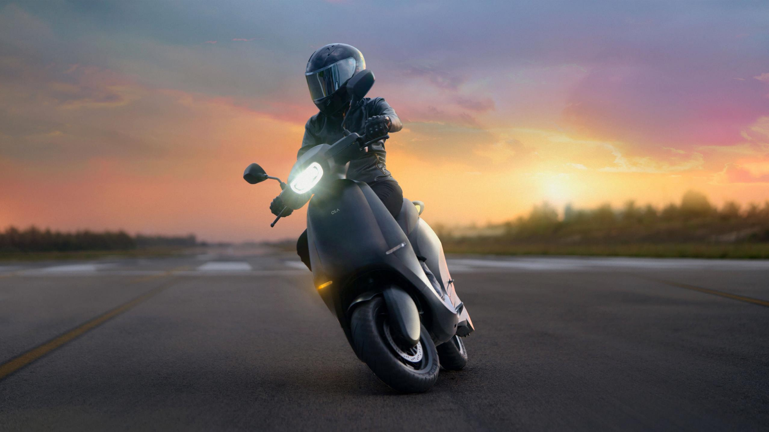
The future of mobility, the most advanced electric scooter company

Slide 2
we bring mobility to a billion people. Change the vehicle form factor, change energy source, change sales & distribution, change usage modes. The rise of new mobility
Electric
Form factor
Share
First Electric scooter in INDIA
Build from scratch that meets Indian roads
Make your part of your family

Slide 3
Pitch :
Why Indian consumers have to pay so much fuel if they have cheaper electricity for self-commuting?

Slide 4
Problem :
Growth of population
Hike in fuel prices
Environmental factors

Slide 5
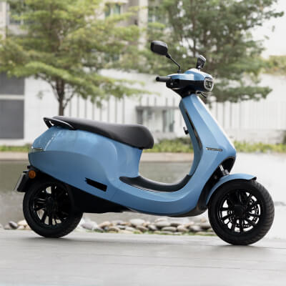
Solution :
Introducting Ola electic scooter
S1 - S1 Pro

Slide 6
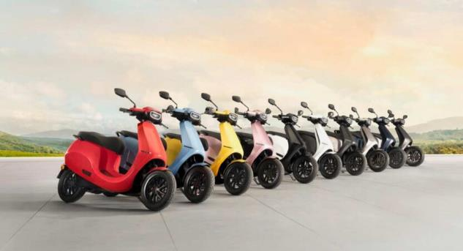
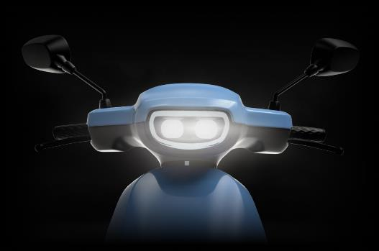
Three Keys to be Successful
10 stunning colours
Large bootspace
Iconic headlamp
Available in glossy and matte finish.
Helmets or a week’s groceries, it fits right in.
Distinguishing personality that shines through.

Slide 7
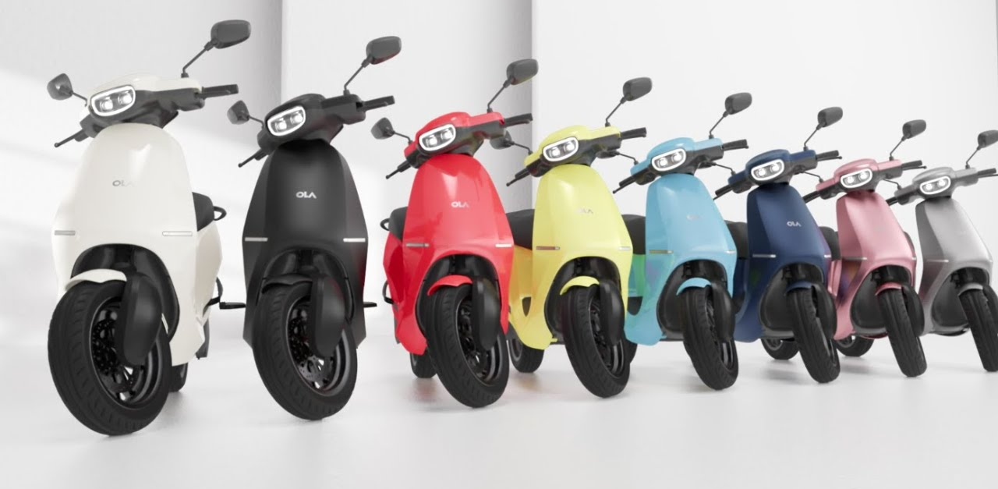
Business Model :
Distribution Model
200 outlets
200 charging stations
Home service

Slide 8
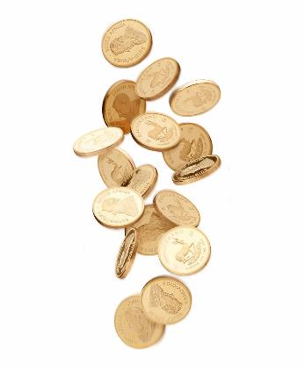
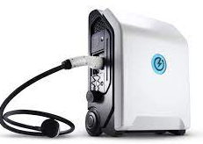
WRITE HERE ABOUT YOUR COMPANY
Three Easy Steps
Ownership made easy
Home service Get assistance sitting in your comfort zone.
Charge on the go Hypercharger network across the country
Save more
Almost 43% lesser cost compared to petrol scooter

Slide 9
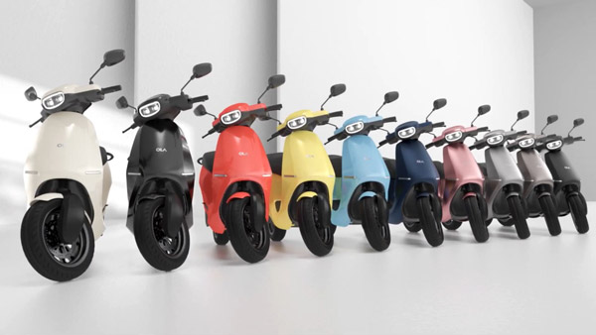
Pricing Tables
 | Ola S1 | Ola S1 Pro
Max speed | 90 KM/HR | 115 KM/HR
0 – 40 km/HR | 3.6s | 3s
Modes | Normal, Sports | Normal, Sports, Hyper
Rs.1,20,000 | Rs.1,20,000 | Rs. 1,39,999

Slide 10
New Mobility. In India, just 2 per cent (30 million) people own a four-wheeler and only 12 per cent (160 million) own a two-wheeler.
“That means more than a billion people in India have been shut out of mobility by this system!,"
We are People with Vision
From electric scooters, cars to drones and flying cars, Ola Chairman and Group CEO Bhavish Aggarwal on Thursday shared his vision of the future of mobility -

Slide 11
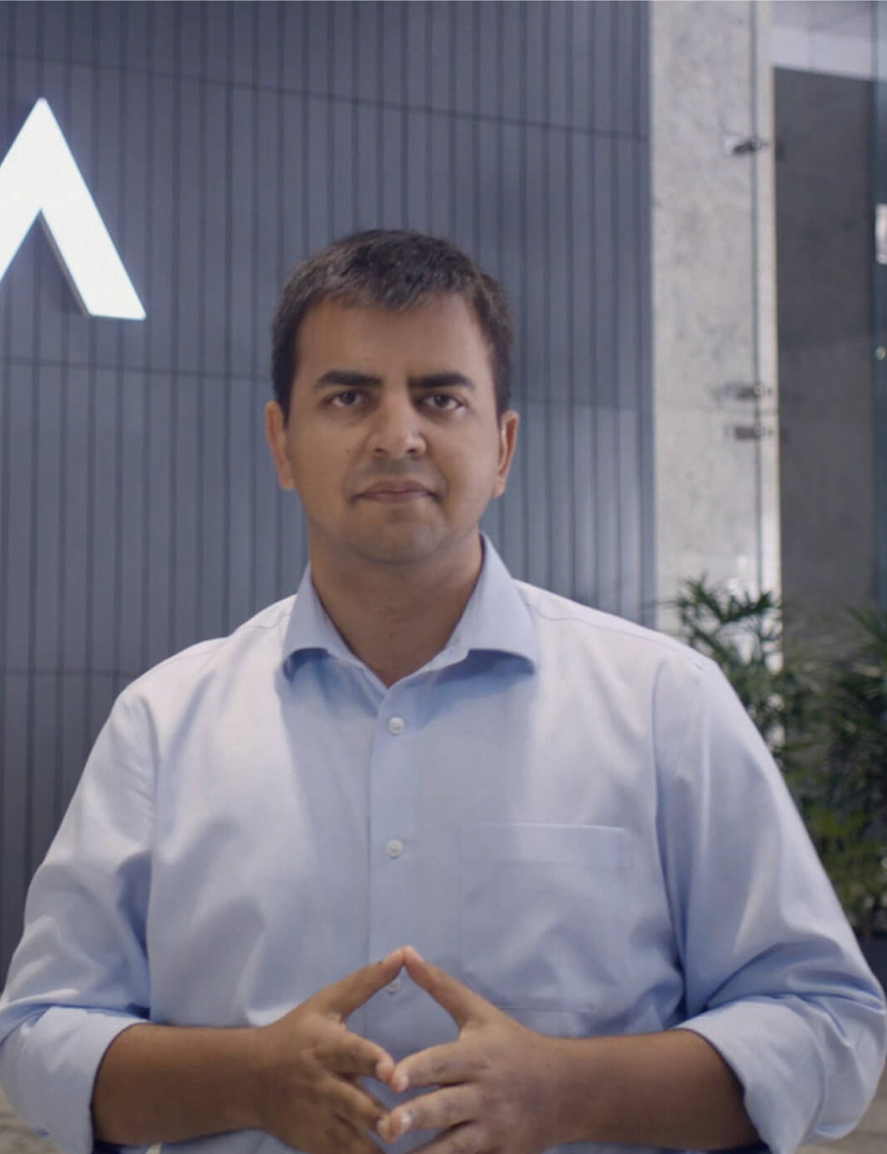
Worldwide Division
"We are going to be launching internationally...this financial year itself, we will be selling internationally also. We start with India first but soon, we move into international markets with a focus on Europe," Ola Chairman and Group CEO Bhavish Aggarwal

Slide 12
Thank you
https://olaelectric.com/

